Slide 1
Outline
Binary Trees
Traversing Binary Tree
Red-Black Trees
Red-Black Tree Insertions
2-3-4 Trees

Slide 2
Introduction to 2-3-4 Trees
The 2, 3, and 4 in the name 2-3-4 tree refer to how many links to child nodes can potentially exist in a given node.
For nonleaf nodes, the following three arrangements are possible:
A node with one data item always has two children
A node with two data items always has three children
A node with three data items always has four children
Thus, if L – number of child links, and D – number of data items. L = D + 1

Slide 3
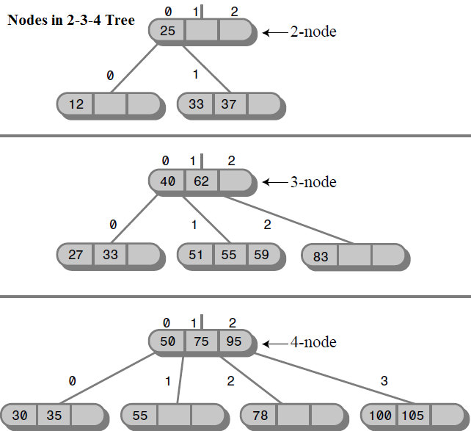
Introduction to 2-3-4 Trees (Cont.)
Why a 2-3-4 tree is not called a 1-2-3-4 tree? Because a node cannot have only one child.

Slide 4
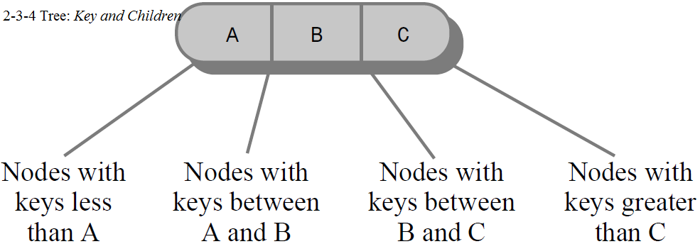
2-3-4 Tree Organization
Data items in a link were numbered from 0 to 2, and the child links from 0 to 3.
The data items in a node are arranged in ascending key order from left to right.
2-3-4 tree characteristics:
All children in the subtree rooted at child 0 have key values less than key 0.
All children in the subtree rooted at child 1 have key values greater than key 0 but less than key 1.
All children in the subtree rooted at child 2 have key values greater than key 1 but less than key 2.
All children in the subtree rooted at child 3 have key values greater than key 2.

Slide 5
Searching for a Data Item in 2-3-4 Tree
Finding a data item with a particular key is similar to the search routine in a binary tree.
You start at the root, and, unless the search key is found there, select the link that leads to the subtree with the appropriate range of values.

Slide 6



Mon., 7-March-2016
@ 15:00
Homework 23 submit to: fe.assignment@gmail.com
6
Create a 2-3-4 Tree.
Create a function for searching a data item in 2-3-4 Tree
Late submission: the score will be minus 10% for every hour

Slide 7
To be continued…

